Slide 1


CISC450 Computer Networks
Lesson 8
Digital Subscriber Line
Slides courtesy of
Cisco Systems and myself

Slide 2




Defining DSL: Digital Subscriber Loop
Customer
DSL
Value-Added
Packet Network
DSL
“Modem”
Copper
Loop
DSL
“Modem”
Like dial, cable, wireless, and T1, DSL is a Transmission Technology, NOT a full end-to-end solution
Users don’t “buy” DSL, they “buy” services, such as high-speed Internet, leased line, VPN, and Video on Demand

Slide 3
Transporting Electrical Signals
Common types of transmission media
  Wire pair
  Coaxial cable
  Fiber optic cable
  Radio

Slide 4
Wire Pair
Typically use a copper conductor
Attenuation (loss)
  Dissipation of signal strength as it travels along a transmission medium
  Typically expressed in decibels (dB)
    L_{db}=10log(P₁/ P₂), where P₁ is the power of the signal where it enters the wire and P₂ is the power at the distant end

Slide 5
Wire Pair
Crosstalk
  Noise induced in a pair of wires from nearby wire pairs
  Commonly occurs when wires are placed closed together such as in a telephone cable
  Problem is remedied by twisting the pairs together; hence the term twisted pair

Slide 6
Wire Pair
Delay distortion
  Varies directly with the length of the line
  Little effect on voice transmissions
  Restricts data rate for digital/data transmissions
  Caused by the capacitance between
    One wire and the other of a pair
    Between each wire and ground
    Between each wire and shield (if present)

Slide 7
Capacitance
Affects alternating current circuits
Capacitor
  Defined as two conductors separated by an insulator; ie – a wire pair
The capacitance of two parallel open wires of great length contain a sufficient amount of capacitance

Slide 8
Bandwidth
IEEE definition
  “the range of frequencies within which performance, with respect to some characteristic, falls within specific limits”
Bandwidth of twisted pair
  PSTN subscriber access provides 2MHz over 1 mile of length
  Category 5 twisted pair only has a 67dB loss at 100MHz at lengths of 1000 feet

Slide 9
Equalization
Frequency response of coaxial cable is exponential
  At 100kHz loss ~ 1dB; at 10MHz loss ~ 12dB
Equalization levels out this frequency response
  What is it????

Slide 10
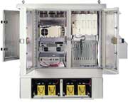
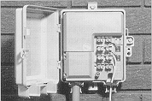
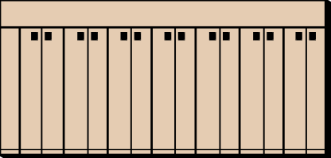
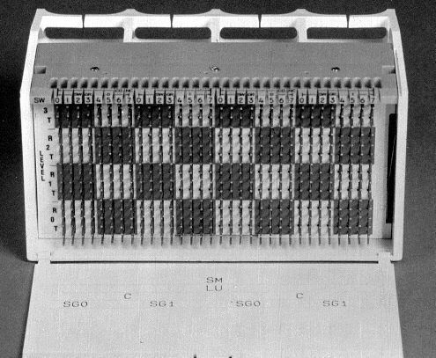
Local Loops
Pedestals
NID
MDF
Loops
89-block

Slide 11


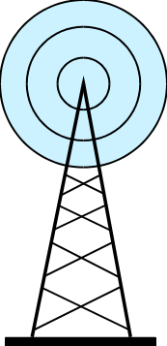

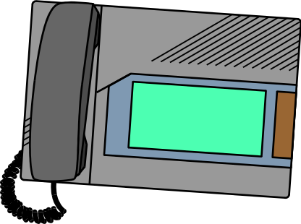
Noise Sources in Outside Plant
Lightning
Computers
Radio
Transmitters
Other telecom services
Motors, lighting, welders,
power switching, appliances ...

Slide 12
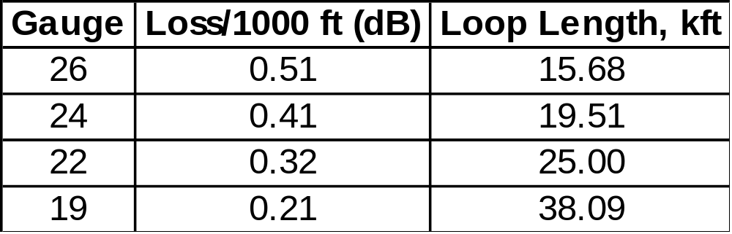
Loop Limits
Analog Telephone Service
Limited to 8 dB loss at 1000 Hz.
Loss dependent upon
  Wire gauge
  Temperature
Representative low-cap cable
at 25º C.

Slide 13
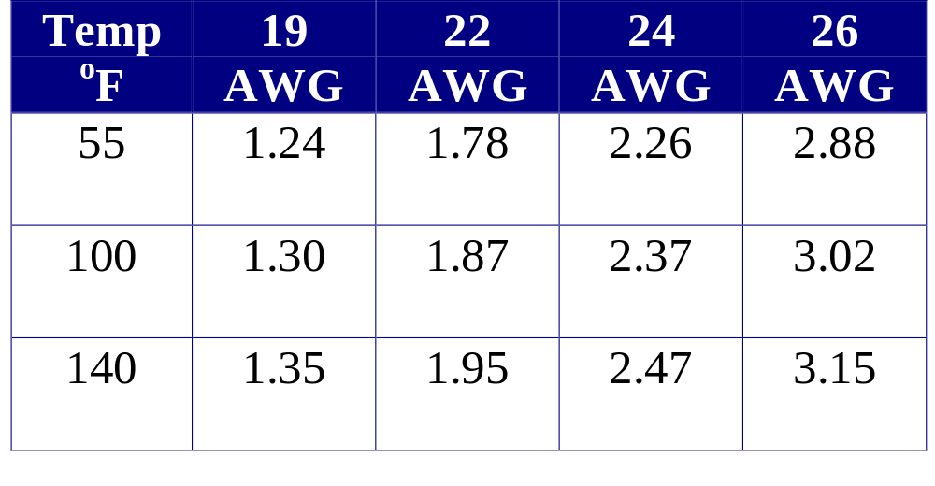
Temperature Effects
dB loss per mile; 1000 Hz signal
Unloaded PIC

Slide 14
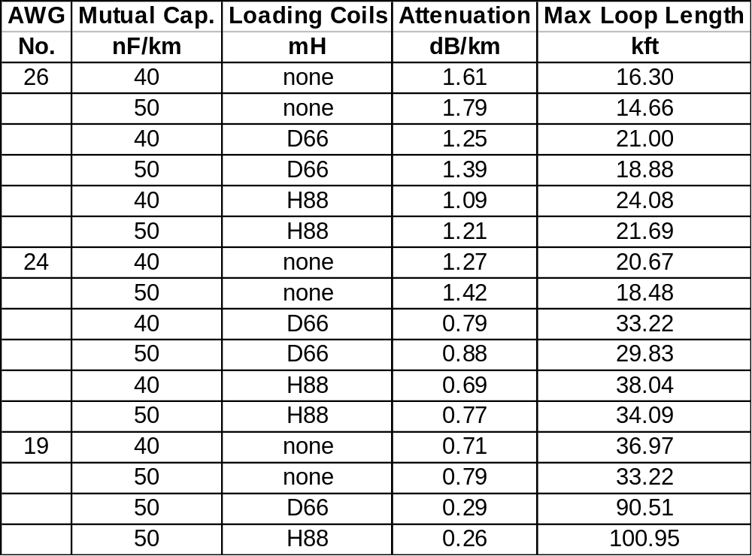
Properties of Conductors

Slide 15
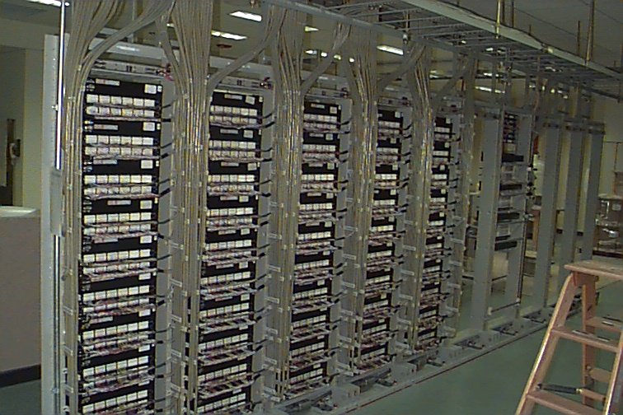
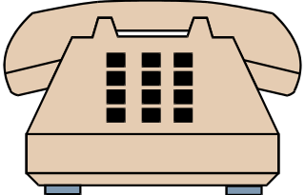

Terminology
AWG - American Wire Gauge
Bridge Tap - an unused, open-circuited, parallel-connected cable pair on a loop
Bridge Tap

Slide 16
Cable Construction
Sheath
  Armored (gopher protection) - lead/steel
  Dielectric
Fill
  Air filled (pressurized?)
  Gel-filled (icky-PIC)
Insulation
  Paper pulp
  Plastic

Slide 17
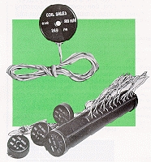
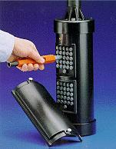
Loading Coils
Used to extend useful length of loops for voice service
Counteracts the effects of cable capacitance
BAD NEWS for high-speed digital services - causes excessive attenuation at frequencies above voice-band

Slide 18
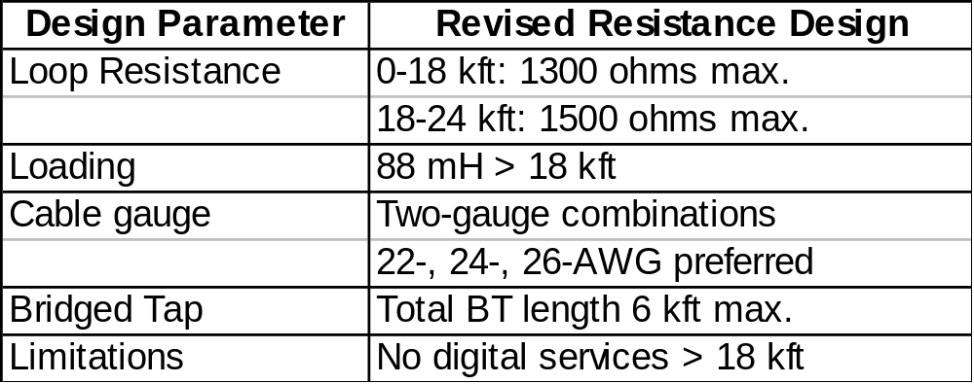
Loop Design Philosophies
Revised Resistance Design (RRD)

Slide 19
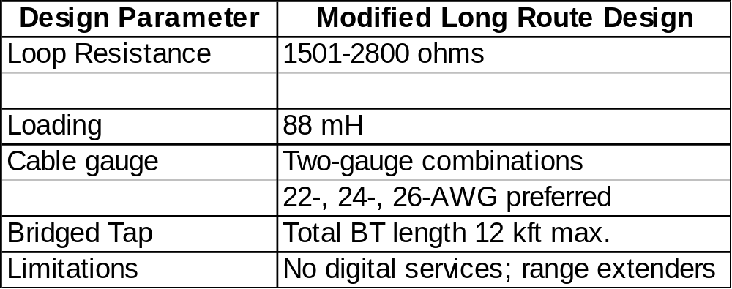
Loop Design Philosophies
Modified Long Route Design (MLRD)

Slide 20

Wire Centers and Cable Plant
Political Boundary
Wire Center
18kft
Carrier Serving Area

Slide 21
DSL Modem Technology
DSL Service
Max. Data Rate Down/Uplink (bps)
Line Coding Technology
Analog Voice Support
Max. Reach (km-feet)
VDSL–
Very High Bit Rate DSL
25M/1.6M
or 8M/8M
???
Yes
.9–3,000
Residential
SOHO
Business
ADSL–Asymmetric DSL
8M/1M
CAP & DMT
Yes
5.5–18,000
IDSL–ISDN DSL
144K/144K
2B1Q
No
5.5–18,000
SDSL–Symmetric DSL
768K/768K
2B1Q / CAP
No
6.9–22,000
HDSL2–
High Bit Rate DSL
1.5M–2.0M/
1.5M–2.0M
Optis
No
4.6–15,000
Trade-off is Reach vs. Bandwidth
Reach numbers imply “Clean Copper” (no taps or coils)
Different layer 1 transmission technologies,we need a common upper protocol layer to tie them together

Slide 22
RADSL (Rate Adaptive ADSL)
  Mass deployment technology
    Good Reach
    Preserves Baseband POTS
    Rate adjusts to local loop conditions
    Good Spectral Compatibility
  Competing line code variations - CAP, DMT, G.Lite

Slide 23
Carrierless Amplitude and Phase
One Supplier (GlobeSpan)
Utilizes CAP encoding within upstream and downstream multiplexed carriers
Rate adapts by modifying #bits/cycle (Constellation size) + Carrier baud rate
POTS
Upstream
Downstream
136 kHz
340 kHz
680 kHz
952 kHz
1080 kHz
136 kHz
4 kHz
f1
f2

Slide 24
Discrete Multi-Tone
ANSI T1.413 Standard for ADSL
Multiple Suppliers
Utilizes QAM line code within many multiplexed bands or “tones”
Rate adapts by changing or zeroing-out bits/tone
POTS
Upstream
Downstream
4 kHz
f1
f2

Slide 25
G.Lite
Sub-rate (<1.5Mbps), splitterless, consumer-oriented standard
Promoted by UAWG (Intel, Microsoft, Compaq)
Based on DMT standard (lower 128 tones)
Should interoperate with “full-rate” DMT (g.hs used to signal at startup)
Targeted for 1H 1999
POTS
Upstream
Downstream
4 kHz
f1
f2

Slide 26
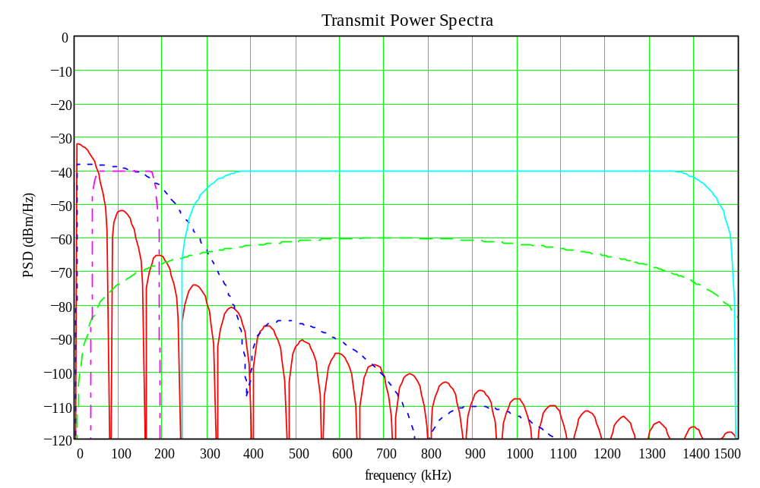
Frequency Spectrum Utilization
ISDN 2B1Q
RADSL Upstream
RADSL Downstream
(1088 baud)
HDSL 2B1Q
T1 AMI

Slide 27
Crosstalk
Customer
Upstream
DSL
“Modem”
Downstream
DSLAM
Downstream power is highest at the DSLAM and lowest at the CPE.
Upstream power is lowest at the DSLAM and highest at the CPE.
If these signals are in different frequency spectrums then they will not crosstalk, otherwise there will be interference from one signal to the other.

Slide 28


ATM over xDSL
Multiple connection multiplexing
Built in QoS / CoS for newer services (EXAMPLES?)
ATM
DSL Transmission Technology

Slide 29
IDSL
Legacy CPE requires that the access link use HDLC or Frame links.
ATU-C on DSLAM will interwork from Frame to ATM
HDLC / Frame
DSL Transmission Technology

Slide 30
ADSL Terminology
ATU-C: ADSL Transmission Unit, Central
  The ADSL point of termination in the central office
  An ADSL modem
ATU-R: ADSL Transmission Unit, Remote
  The remote user’s ADSL modem
  The CPE
DSLAM: DSL Access Multiplexer
  Central office device that concentrates many ADSL connections into one
  DSLAM contains ATU-Cs

Slide 31










End-to-End ADSL Architecture
PSTN
DSLAM
ATU-R
IP
IP
ISP
ATM/
Frame Relay
Network
ISP
L2/L3
Services
Aggregator
Corporate
UCP
ATU-R
Content
Providers
Local Loop
Central Office
Broadband Network

Slide 32




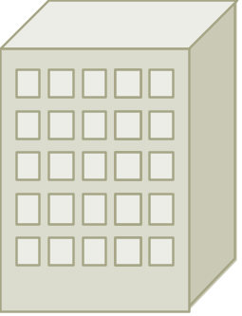
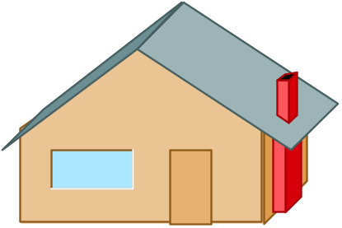




Connection Variables
Destination
Backbone
Central Office
Remote
Corporation
xDSL
ISP
Network service definition has significant effect
on data connection
  How many destinations? 1 or N?
  Simple connectivity or value-added service?
  Cells to the user or frames?
  Flat-rate billing or usage based?

Slide 33
The Future for xDSL
How many systems will be upgraded
to DSL for POTS service?
How many Loops qualify?
How popular will competing
technologies become?
How will ISP’s price higher
Internet services?
Is there a market for access networks that can provide multiple services?
Do we need it at all?

